Slide 1
SDLC (Software Development Life Cycle)
It is a process followed by software industry to design develop and test a high quality software

Slide 2
IMPORTANCE OF SDLC
It acts as a guide to the project and meet client’s objectives.
It helps in evaluating, scheduling and estimating deliverables.
It provides a framework for a standard set of activities.
It ensures correct and timely delivery to the client.

Slide 3
PHASES/STAGES OF SDCL
Planning (Requirement gathering and analysis)
Design
Implementation or coding
Testing
Deployment
Maintenance

Slide 4
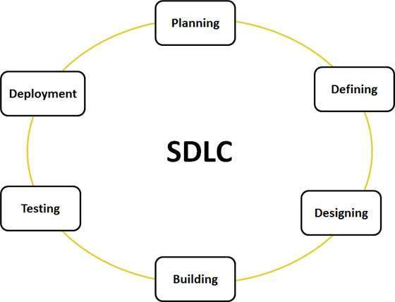

Slide 5
TYPE OF SDLC
WATER FALL MODEL
V MODEL
SPIRAL
BIGBANG
AGILE

Slide 6
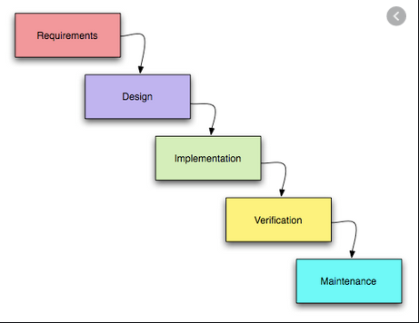
WATERFALL-MODEL

Slide 7
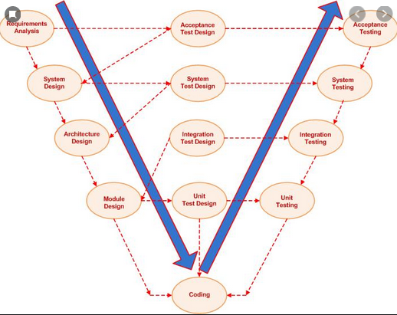
V MODEL

Slide 8
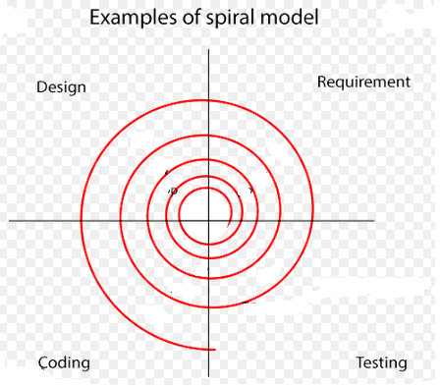
SPIRAL MODEL

Slide 9
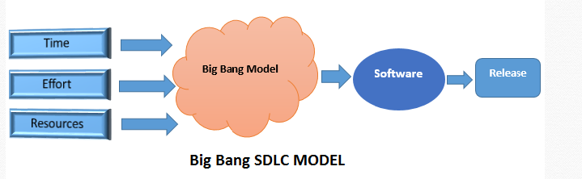
BIGBANG-MODEL

Slide 10
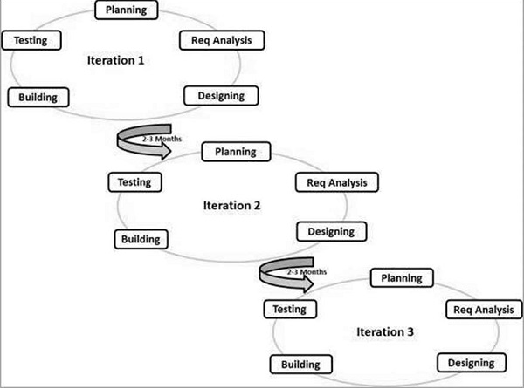
AGILE

Slide 11
SCRUM
Scrum in Agile is a process that allows software development teams to focus on delivering business values in shortest time by rapidly and repeatedly inspecting actual working software. It focuses on accountability, teamwork and iterative progress towards well-defined goals. Scrum Framework usually deals with fact that requirements are likely to change or mostly not known at the beginning of project.

Slide 12
SCRUM ROLES
SCRUM MASTER
PROJECT OWNER
SCRUM TEAM

Slide 13
WHAT IS SOFTWARE TESTING
Testing is the process of evaluating a system or its component(s) with the intent to find whether it satisfies the specified requirements or not.
Software Testing is Important because if there are any bugs or errors in the software, it can be identified early and can be solved before delivery of the software product. Properly tested software product ensures reliability, security and high performance which further results in time saving, cost effectiveness and customer satisfaction.

Slide 14
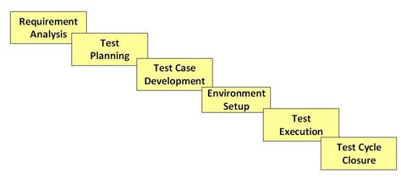
STLC (SOFTWARE TEST LIFE CYCLE)

Slide 15
DEFECTS CYCLE
A Defect life cycle, also known as a Bug life cycle, is a cycle of a defect from which it goes through covering the different states in its entire life. This starts as soon as any new defect is found by a tester and comes to an end when a tester closes that defect assuring that it won’t get reproduced again.

Slide 16
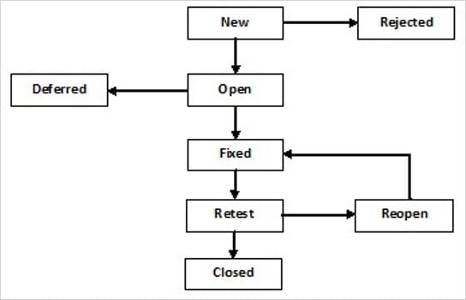
DEFECT WORK FLOW

Slide 17
Severity
Severity or Defect Severity in testing is a degree of impact a bug or a defect has on the software application under test. A higher effect of bug/defect on system functionality will lead to a higher severity level. A quality assurance engineer usually determines the severity level of a bug/defect.
Severity is categorized into five types : critical. major, moderate, minor and cosmetic.

Slide 18
PRIORITY
is defined as the order in which a defect should be fixed. Higher the priority the sooner the defect should be resolved.
Defects that leave the software system unusable are given higher priority over defects that cause a small functionality of the software to fail.
Priority is categorized into three types : low, medium and high

Slide 19
TEST SCENARIO
A TEST SCENARIO is defined as any functionality that can be tested. It is also called Test Condition or Test Possibility. As a tester, you should put yourself in the end user’s shoes and figure out the real-world scenarios and use cases of the Application Under Test.

Slide 20
TEST CASE
A test case is a document, which has a set of test data, preconditions, expected results and postconditions, developed for a particular test scenario in order to verify compliance against a specific requirement.
Test Case acts as the starting point for the test execution, and after applying a set of input values, the application has a definitive outcome and leaves the system at some end point or also known as execution postcondition.

Slide 21
TEST CASE PARAMETERS
Test Case ID
Test Scenario
Test Case Description
Test Steps
Prerequisite
Test Data
Expected Result
Test Parameters
Actual Result
Environment Inform

Slide 22
TEST PLAN
A Test Plan is a detailed document that describes the test strategy, objectives, schedule, estimation, deliverables, and resources required to perform testing for a software product. Test Plan helps us determine the effort needed to validate the quality of the application under test. The test plan serves as a blueprint to conduct software testing activities as a defined process, which is minutely monitored and controlled by the test manager.

Slide 23
TEST PLAN
Test plan identifier
Introduction
Test items
Features to be tested
Features not to be tested
Approach
Item pass/fail criteria
Test deliverables
Testing tasks

Slide 24
TEST PLAN
Environmental needs
Responsibilities
Staffing and training needs
Schedule
Risks and Mitigation
Approvals

Slide 25
DIFFERENT TYPE OF TESTING
FUNCTIONAL TESTING
NON FUNCTIONAL TESTING
BLACK BOX TESTTING
WHITE BOX TESTING
SMOKE TESTING
SANITY TESTING
INTEGRATION TESTING

Slide 26
MORE TESTING….
ADHOC TESTING
SYTEM TESTING
REGRESSION TESTING
SYSTEM INTIGRATION TESTING
PERFORMANCE TESTING

Slide 27
TYPES OF PERFORMANCE TESTING
Load testing
Stress testing
Endurance testing
Spike testing
Volume testing
Scalability testing

